Slide 1
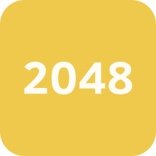
2048 recreated in Java
By Timothy Bui

Slide 2
Objective
Attempt to faithfully recreate 2048 in Java from scratch
Have a functioning puzzle game just like the real game
Minimize how many times I have to go to Stack Overflow for small details (lol)

Slide 3
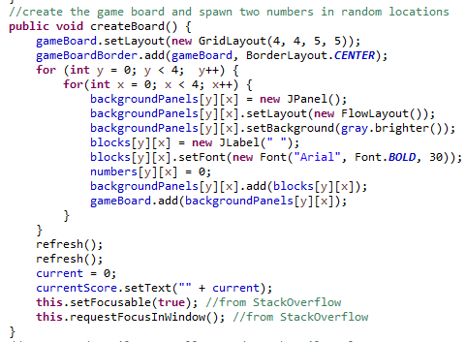
Creating the board
Set layout
Add board panel to center panel
Initialize new JPanels in the 2d JPanel array(s)
Spawn 2 starting tiles using the refresh() method
Set score to 0
setFocusable and requestFocusInWindow required for the KeyListener to work

Slide 4
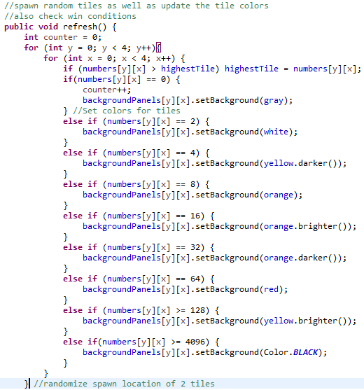
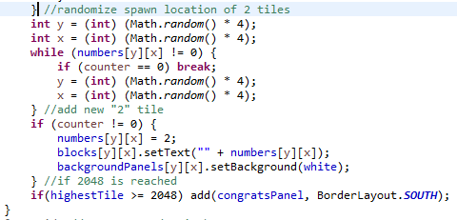
The Refresh Method
Spawn a random tile
Update the tile colors
Keep track of progress/ win condition

Slide 5
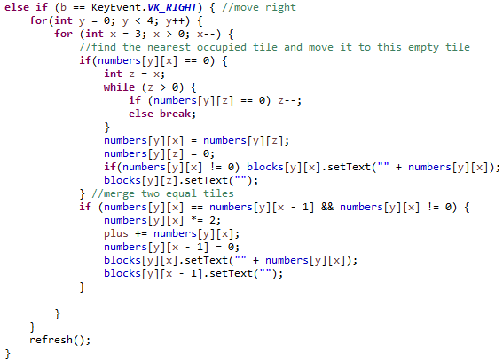
Example of Tile Movement
Numbers array holds integer values
“z” integer “moves left” until the next occupied tile
Tiles are then shifted over
Matching tiles to the right are merged and text is updated
Score is tracked

Slide 6
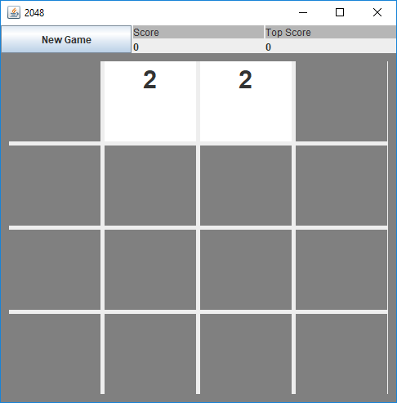
New Game

Slide 7
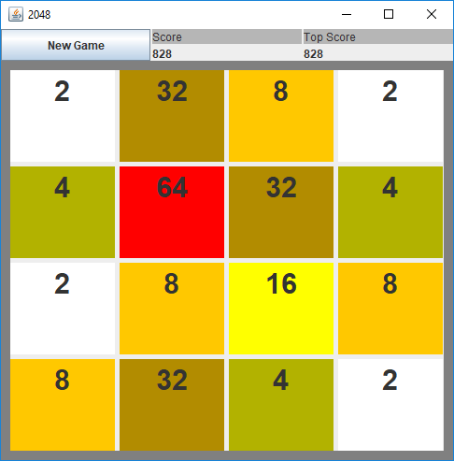
Full board

Slide 8
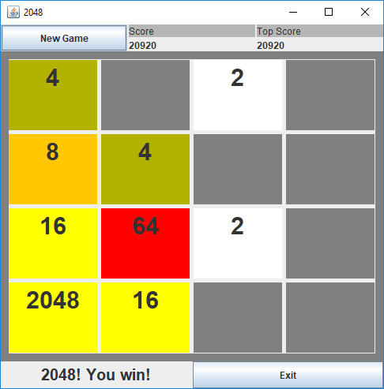
Winning
the game
Can still continue to play if player chooses to

Slide 9
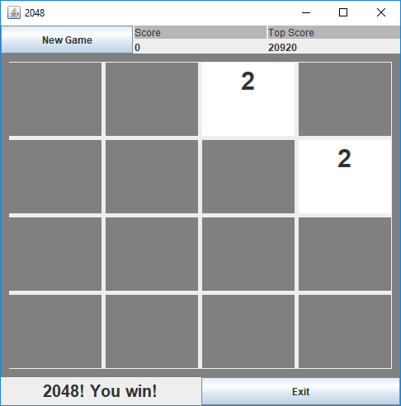
Clicking new
game button

